Slide 1
RCDC Research Funding Analysis Dashboard
Professional Project Report Created by: Abhijeet Kedar

Slide 2
Introduction
• This internship project focuses on analysing research funding data using Tableau. The purpose of this analysis is to understand funding trends, compare funding across different research and disease areas, and observe how funding has changed over time. To achieve this, an interactive dashboard was created using multiple visualization techniques. The dashboard allows users to explore the data using filters such as year and research area.

Slide 3
Dataset Overview
Dataset: RCDC Research Funding Summary
Time Period: 2008 to 2022
Tool Used: Tableau Public / Tableau Desktop Public Edition
Measure Used: Funding Amount (Million USD)
The dataset contains funding information for multiple research and disease areas across different years. This data helps in analysing long-term trends and funding distribution.

Slide 4
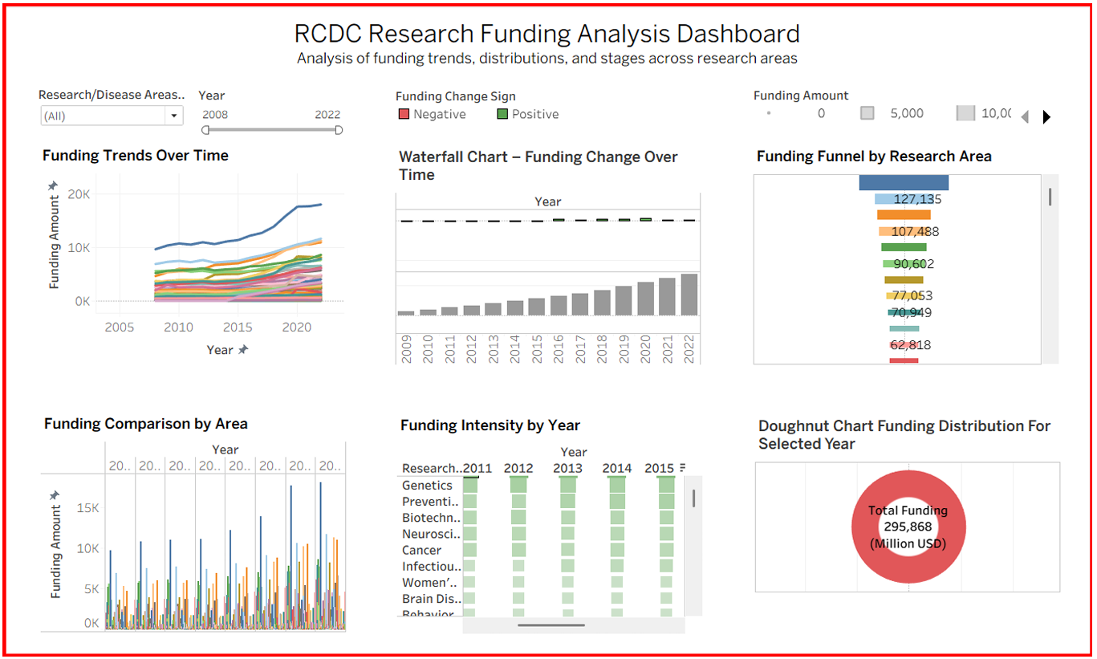
Dashboard

Slide 5
Dashboard Description
The dashboard is designed to give a complete overview of research funding patterns. It includes multiple charts arranged in a structured layout for better understanding.
Interactive filters are provided at the top to allow users to focus on specific areas or time periods.
Research/Disease Area filter
Year range filter
Funding amount indicator

Slide 6
Visualization Analysis
1 Funding Trends Over Time (Line Chart) :
This chart shows how funding has changed from 2008 to 2022 for different research areas.
Key Observations:
• Overall funding shows a steady increase over time.
• Some research areas grow faster compared to others.
• Funding growth is more visible after 2015.
This chart helps in understanding long-term funding behaviors.

Slide 7
Visualization Analysis
2 Waterfall Chart:
Funding Change Over Time - The waterfall chart displays year-wise changes in funding.
Key Observations:
• Most years show positive funding growth.
• Negative changes are minimal compared to positive changes.
• The chart clearly shows how funding accumulates year by year.
This visualization is useful for tracking funding increases and decreases.

Slide 8
Visualization Analysis
3 Funding Funnel by Research Area :
The funnel chart represents funding stages across different research areas. Key Observations:
• A few research areas receive very high funding.
• Funding gradually decreases for other areas.
• It highlights funding concentration.
This chart helps in identifying priority research areas.

Slide 9
Visualization Analysis
4 Funding Comparison by Area (Bar Chart) :
This chart compares funding across different research areas and years.
Key Observations:
• Funding varies significantly across research areas.
• Some areas consistently receive higher funding.
• It is easy to compare multiple areas at once.
This visualization supports comparison-based analysis.

Slide 10
Visualization Analysis
5 Funding Intensity by Year (Heat Map) :
The heat map uses colour intensity to represent funding levels.
Key Observations:
• Darker colours indicate higher funding.
• Recent years show higher funding intensity.
• Some research areas remain consistently strong.
This chart provides a quick visual summary of funding strength.

Slide 11
Visualization Analysis
6 Doughnut Chart :
Funding Distribution for Selected Year - The doughnut chart shows total funding for a selected year.
Key Observations:
• Displays overall funding clearly in the center.
• Helps in understanding yearly funding distribution.
• Useful for summary-level insights.

Slide 12
Insights
Research funding has increased over the years.
Funding distribution is uneven across research areas.
Certain areas consistently receive higher funding.
Recent years show stronger funding growth.
Interactive filters improve analysis flexibility.

Slide 13
Conclusion
• The RCDC Research Funding Analysis Dashboard provides a clear and interactive way to analyses funding data. Using multiple visualization techniques helps in understanding trends, comparisons, and distributions effectively. This project demonstrates practical skills in Tableau, data visualization, and analytical thinking, making it suitable for an internship-level submission.

Slide 14
Thank You

